Slide 1


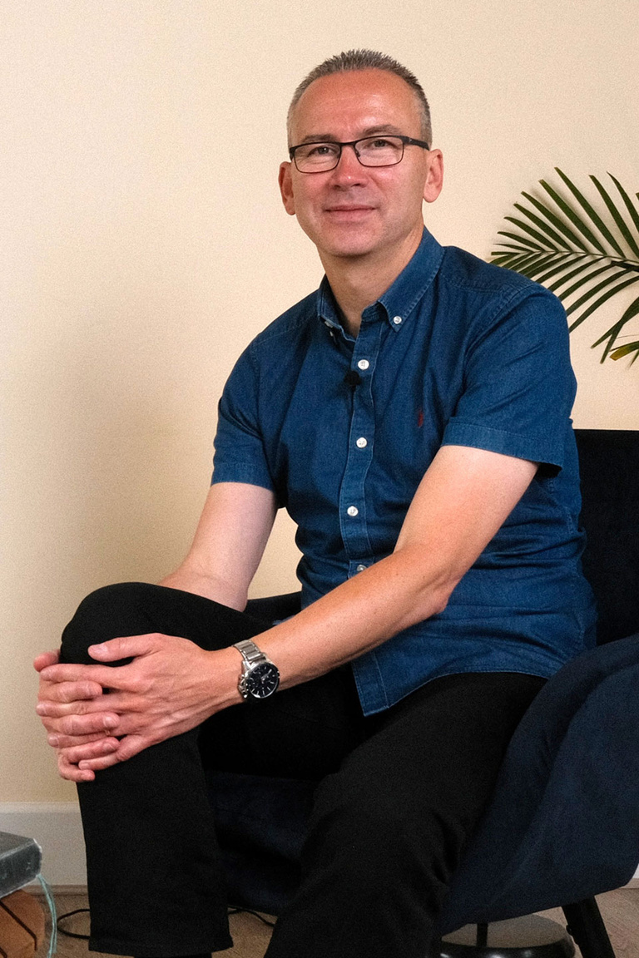

Discover the power of the Holy Spirit in this 7-part course
holyspiritcourse.com

